Slide 1
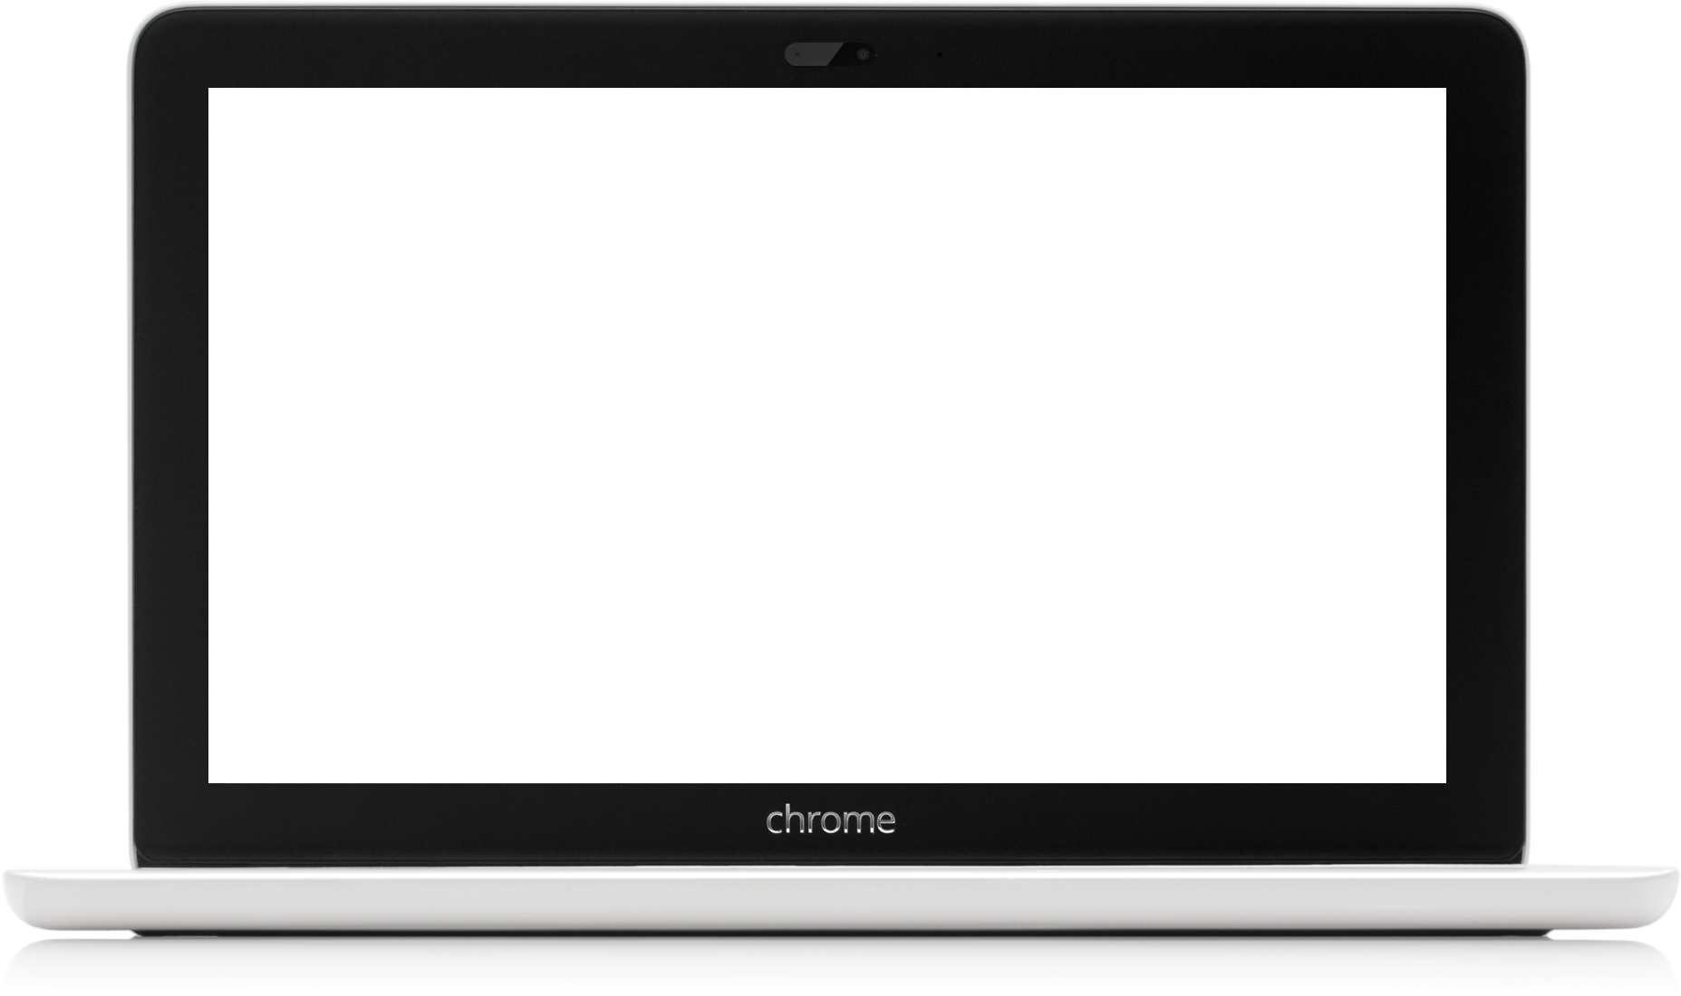
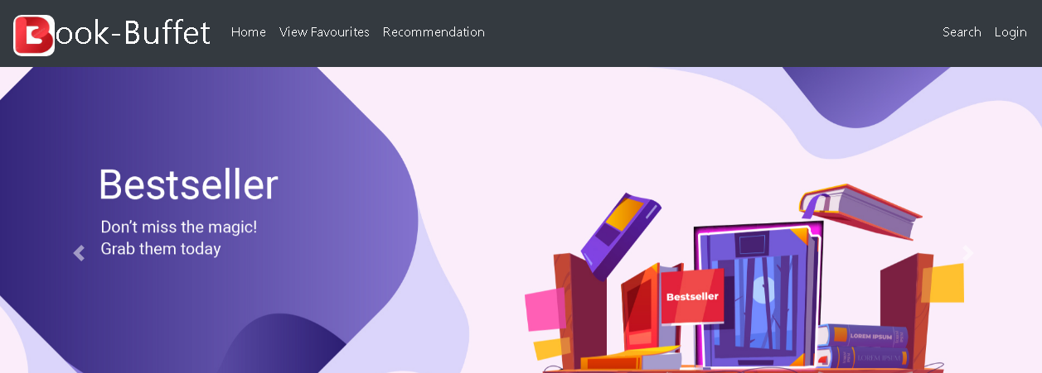

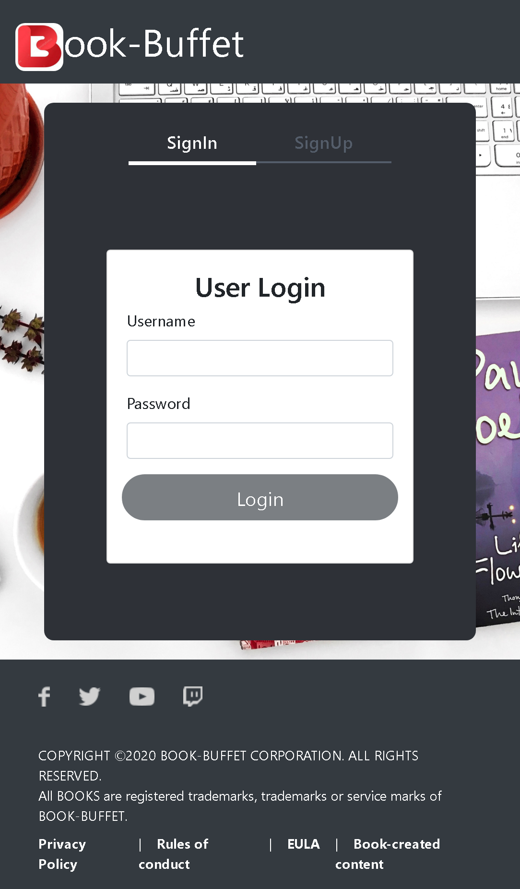
Book-Buffet
Team:
Prachi
Arnab
Nishanth Nayak T

Slide 2
Problem Statement
Objective
Microservices
Project Overview
Onboarding-Architecture
Project Flow
Technology and Tools Used
Conclusion
Outline

Slide 3

The traditional way of booking the ticket for the movie is the customer need to go to the specific theater where the desired movie was playing and need to stand in queue and buy the ticket for the movie this will become more difficult for a person in order to overcome this problem this project gives real life understanding of online movie ticket booking system and activities performed by various roles in supply chain.
Problem Statement

Slide 4
Objective
Our objective is to provide best user experience so that he/she can book tickets easily without the need of standing in a queue outside movie hall

Slide 5
Authentication API
Recommendation API
Favourite API
Microservices

Slide 6
Project Overview

Slide 7
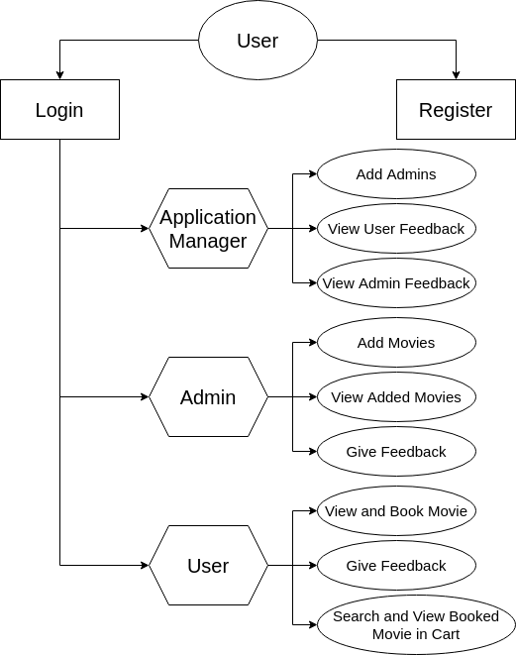
Project Overview

Slide 8
Onboarding Architecture

Slide 9
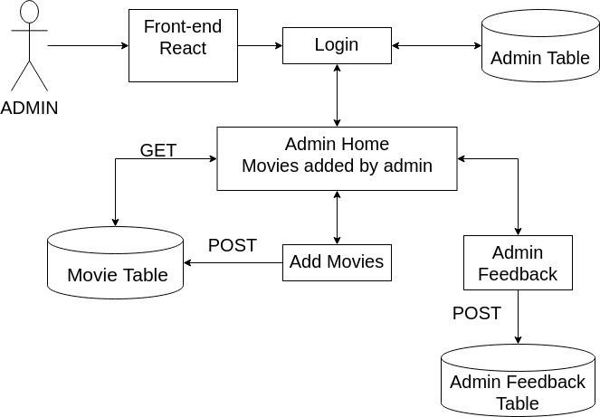
Architecture (Admin)

Slide 10
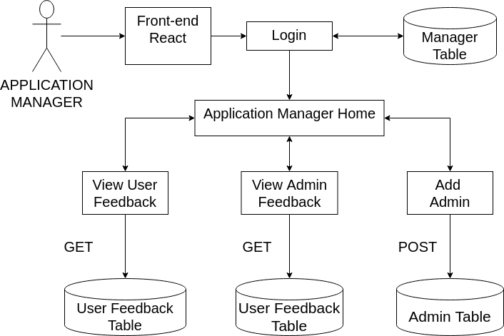
Architecture (Application Manager)

Slide 11
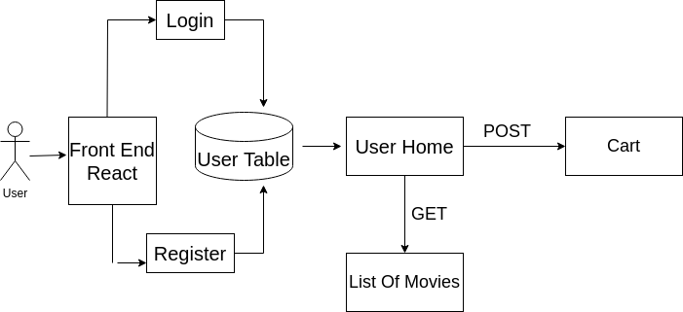
Architecture (User)

Slide 12
Project Flow

Slide 13
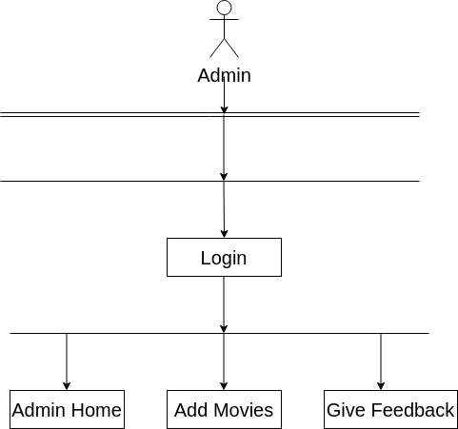
Project Flow (Admin)

Slide 14
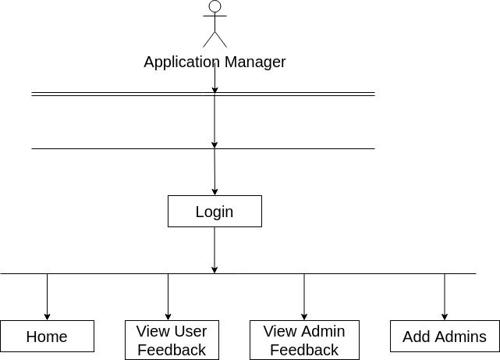
Project Flow (Application Manager)

Slide 15
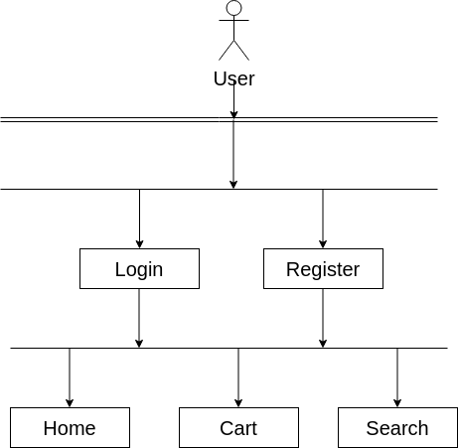
Project Flow (User)

Slide 16






Technologies and Tools Used

Slide 17
Conclusion
This Application helps customer in having immediate information about running movies and reserve their seat without wasting their precious time
User friendly interface for the admins to add and delete movie information

Slide 18
Thank You

Slide 19


